Slide 1
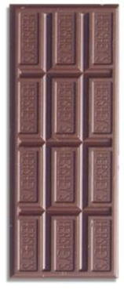
Multiplying Fractions by a Whole Number

Slide 2
Activating Strategy 1. Students, on your Post It note, write three things you know about multiplication. We will discuss your ideas. (Teacher will create a chart)
2. With your buddy, solve the following multiplication problems. 2 X 5 ½ X 5

Slide 3
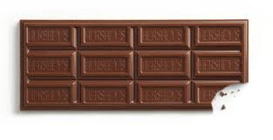
Instructional strategy There are 5 students in a group. Each student is given ½ of a Hersey bar. How many Hersey bars do the students have in all? Use your fraction bars to show the answer to this word problem.

Slide 4
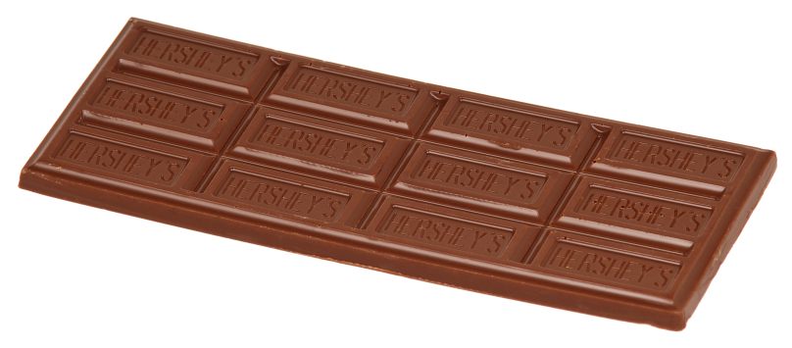
There are 5 students in a group. (make 5 groups)
Each student is given ½ of a Hersey bar. (How many pieces make ½?)

Slide 5
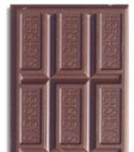
½ ½ ½ ½ ½
What is our total number of Hersey bars?

Slide 6
The total would be: 2 and ½ 2 ½

Slide 7
Independent Practice
Work with a buddy to solve this problem. Use your fraction bars to show your work.
Each kid at the party has ¼ of a square. There are 10 kids at the party. How many square can they make altogether?
Answer: 2 ½

Slide 8
What do you understand now that you didn’t before? Think about how 2 X 5 is different from ½ X 5?

